Slide 1

REACTJS

Slide 2

HELLO!
I am Veena Kumaran
(Business Analyst and Freelancer)
You can find me at @VeenaKumaran27@gmail.com

Slide 3
You Will Learn...........
What is ReactJs
Why ReactJs?
Prerequisites to learn ReactJs
Buzzwords around ReactJs

Slide 4
What is ReactJs?
1

Slide 5

What is ReactJs?
ReactJs is a JavaScript library used for building fast and interactive user interfaces
It was developed by Facebook in the year 2011
Current version in use is 16.7.0
ReactJs follows a component based architecture

Slide 6
What is ReactJs?
Definition :
React is a component based, standard JavaScript library used for creating single page, fast and interactive UI

Slide 7
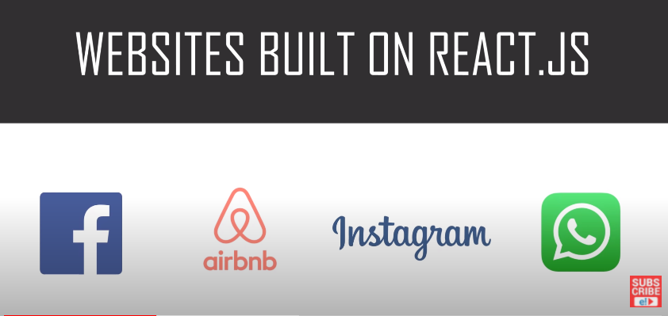
Websites built on ReactJs

Slide 8
Component Based Architecture
Component is a piece of the UI which is independent, isolated and reusable

Slide 9
State and Render methods
State() → describe the state of the element that is displayed (data)
Render() → describes what the UI should look like (component structure)

Slide 10
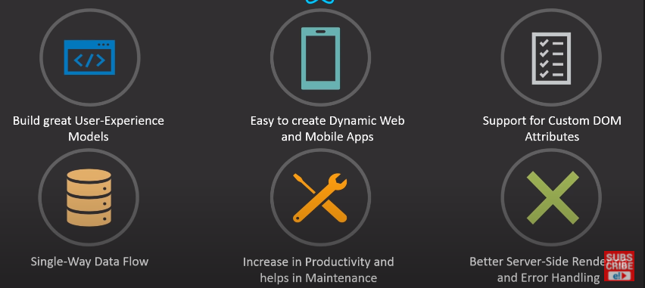
ReactJs Features

Slide 11
Why ReactJs?
2

Slide 12
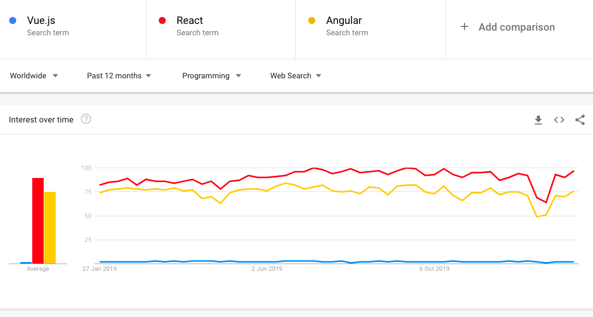
Trends – numbers speak for themselves

Slide 13
Prerequisites
3

Slide 14
Prerequisites
HTML
CSS
JavaScript
JSX
JSON
API

Slide 15
BuzzWords
4

Slide 16
MVC – Model View Controller
View
Model
Controller

Slide 17


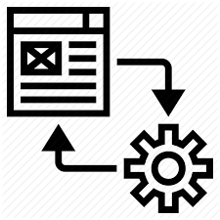
Full Stack
FULL STACK DEVELOPER
CLIENT SIDE
Web Application
HTTP REQUEST
SERVER SIDE
Business Logic
DataBase
API
HTTP RESPONSE
Front End Developer
Back end Developer
Query Languages

Slide 18
MEAN Stack vs MERN Stack
MEAN Stack
Mongo DB
Express Js
Angular Js
Node Js
MERN Stack
Mongo DB
Express Js
React Js
Node Js

Slide 19
Redux
Open Source Js library for managing the state of the objects/application

Slide 20
ENVIRONMENT SETUP

Slide 21
You Will Learn...........
Inspect React Pages
Install node.js
Create basic React app in primitive way
Create basic React app in modern way
Deploy applications using GIT and GitHub

Slide 22
Inspect React Pages
We can inspect React pages using the React Console present as an extension for all the browsers
Download React developer tools :
Search chrome extensions in browser >> chrome web store >> Search ‘React Developer tools’
Add this extension to chrome

Slide 23
Environment Setup
Node.js → Node is a server side cross platform (runtime environment) build on google chrome V8 engine for building fast and scalable n/w applications
Node is basically a collection of packages.
NPM → Node Package Manager
NPM is an interface to Node Js
Online Repo for Node Js packages/modules
Command line utility for Node.js packages
Node.js
package1
package3
package2
NPM
Local System

Slide 24
Environment Setup – Primitive Way
STEP 1 : Install Node
STEP 2 : Create a root folder manually in the required directory
STEP 3 : Generate the package.json file
STEP 4 : Install the Packages
> npm init
> npm install react --save
> npm install react-dom --save

Slide 25
Webpack and Babel
Webpack → module bundle used for setting the development server
Used for setting or changing the port for local host
Babel → Plugins required for Webpack
For eg : transpiler , compiler

Slide 26
Environment Setup – Primitive Way
STEP 5 : Install Webpack and Babel
STEP 6: create the required files : Index.html, Index.js, App.js and main.js
Once webpack-config file is generated, paste the default code in it to make it compatible
> npm install webpack --save
> npm install webpack-dev-server --save
> npm install webpack-cli --save
> npm install babel --save
> type nul > webpack-config.js

Slide 27
Environment Setup – Advanced Way
STEP 1 : Install Node
STEP 2 : Navigate to the required location(mainly as administrator) and launch the cmd prompt
The First command is used to install the create-react-app package from Node
Second command is used to create a react application without any build configuration and will create a project with all the required folders
> npm install –g create-react-app
> create-react-app nameofthefolder

Slide 28


Deploy Applications – GIT & GitHub
GitHub → Web based code-hosting platform used for code collaboration and version control.
GitHub is a remote repository for your codebase, where multiple people can work on the same code simultaneously.
GIT → Distributed version control system designed to track the changes in project files .
GIT is the heart of GitHub and is responsible for everything GitHub-related that happens locally on your computer.
Most Commonly used GIT commands :
GIT clone → clones or duplicates the repository into local
GIT commit → The git commit command will save all staged changes, along with a brief description from the user, in a “commit” to the local repository.
GIT checkout → The git checkout command is a way of switching between branches or version of your application
GIT Push and GIT Pull → will send changes in local to the repo and will accept incoming changes from repo to local

Slide 29
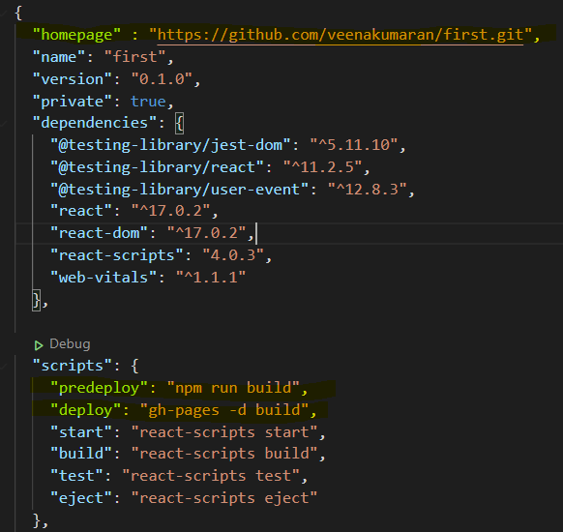
Deploy Applications – GIT & GitHub
STEP 1 : Create A GitHub Account
STEP 2 : Install Git in your machine and Set up Git.
STEP 3 : Install GitHub pages package as dev-dependency
STEP 4 : Add properties to package.json file
“hostname” : “repo link to your project”
"predeploy": "npm run build", "deploy": "gh-pages -d build"
> npm install gh-pages --save-dev

Slide 30
Deploy Applications – GIT & GitHub
STEP 5 : Create a new repo in GitHub and Initialize Git
STEP 6 : Deploy to GitHub pages
> git init
> git remote add origin “GitHub repo link”
> npm run deploy

Slide 31
FILE STRUCTURE IN REACT APP

Slide 32
File Structure
Package.json → stores the list of all node dependencies and the reference to packages installed from through npm
Index.html → starting point for the start of the application i.e. first page that is loaded when the application starts ( only html file – single page app )
It define the template of the browser screen
Index.js → renders or maps the content to the elements/div in index.html
App.js → it is the main component which contains all other components ( container )
Webpack-config.js → for setting up the development server or local host

Slide 33
UNDERSTANDING UI ORIENTATION

Slide 34
UI Screen Template
The entire UI is divided into multiple <div>
Index.html file defines the orientation of the page i.e. the number of <div> the page is dived into broadly
div1
div3
div2

Slide 35
UI Screen Content
For each of the <div> we need to specify the html content that needs to be displayed
Index.js file maps the html content/elements to the <div> tags
div1
HTML Element
HTML Element
div3
div2
HTML Element

Slide 36
SAMPLE REACT APP

Slide 37
Sample React App
To get started, first create a new application.
For any application we essentially have 2 important parts in the program
#1: Creating an Element
#2: Rendering an Element
NOTE : Elements are basically html tags and enclosed content that we want to display on the output

Slide 38
Creating an Element
Create an element :
Create Element
(
‘Tag name’,
Attributes,
Html Content
)
SYNTAX
Const tilte = React.createElement (
‘h1’,
{ id: ‘title’ },
“Hello World”
)
arguments

Slide 39
Rendering an Element
Render an element :
Render Element
(
What you want to render,
Where you want to render
)
SYNTAX
ReactDOM.render (
‘title’,
Document.getElemetById (‘root’)
)
arguments

Slide 40
JSX

Slide 41
JSX Syntax
JSX is basically using html tags directly inside JavaScript code
In JSX,
All expressions are written in { }
These expression include variables, properties or any other Js expression.
NOTE:
In HTML if you want to give Js expression, we use → { }
In HTML, if you want to define any property: value pair i.e. attributes then we use → {{ }}

Slide 42
JSX
In traditional JavaScript, we have output methods to display content on output but now using JSX, we can directly write/embed html content/tags in JavaScript without the output methods
Embedding html content directly to render function
Embedding html content indirectly to render function

Slide 43
JSX
Embedding html content directly to render function
Embedding html content indirectly to render function
ReactDOM.render(
<h1>My Webpage</h1>,
document.getElementById('root')
);
var element = <div><h1>My Webpage</h1><p>hi there........</p></div>
ReactDOM.render(
element,
document.getElementById('root')
);

Slide 44
STYLING

Slide 45
JSX Styling
There are different ways to style content in JSX:
Inline or internal
Using External .css file
Using Modules
Styled components

Slide 46
Inline Styling
In inline styling we can give the styles as follows :
#1 : directly in the tags as attributes
<h1 style ={{backgroundColor : 'black', color : 'orange', textAlign :'center’}
#2 : As style objects
<h1 style ={myStyle}> My Webpage </h1>

Slide 47
External Styling
In external Styling, we can give the styles as follows :
#1 : external css for tags
body {
margin: 0;
font-family: -apple-system, BlinkMacSystemFont, 'Segoe UI', 'Roboto', 'Oxygen',
'Ubuntu', 'Cantarell', 'Fira Sans', 'Droid Sans', 'Helvetica Neue',
sans-serif;
}
#2 : external css classes
.txt{
font-size: 200px; }

Slide 48
JSX Styling
There are different ways to style content in JSX:
Inline or internal
Using External .css file
Using Modules
Styled components

Slide 49
Different types of data in JSX

Slide 50
Different types of Data in JSX
The different types of data which we can use in JSX are
Variable
Object
Arrays/ lists
Array Object

Slide 51
BIG CONCEPT

Slide 52
THANKS!
Any questions?

